Slide 1




Restaurant One Solution

Slide 2

AGENDA
Goals
Project Requirements
Business Modules
Delivery in Numbers
Project Requirements
Tech Stack
Key Highlights
Data Sets
Data Anomalies
Data Dictionary
DB Design
Data Generation Techniques
Visualizations
Demo
Q n A

Slide 3

GOALS
MIGRATE 100% DATA SUCCESFULLY
100% ACCURACY IN MIGRATION
ENABLE HIGH QUALITY BUSINESS INTELLIGENCE EXCEL REPORTS

Slide 4
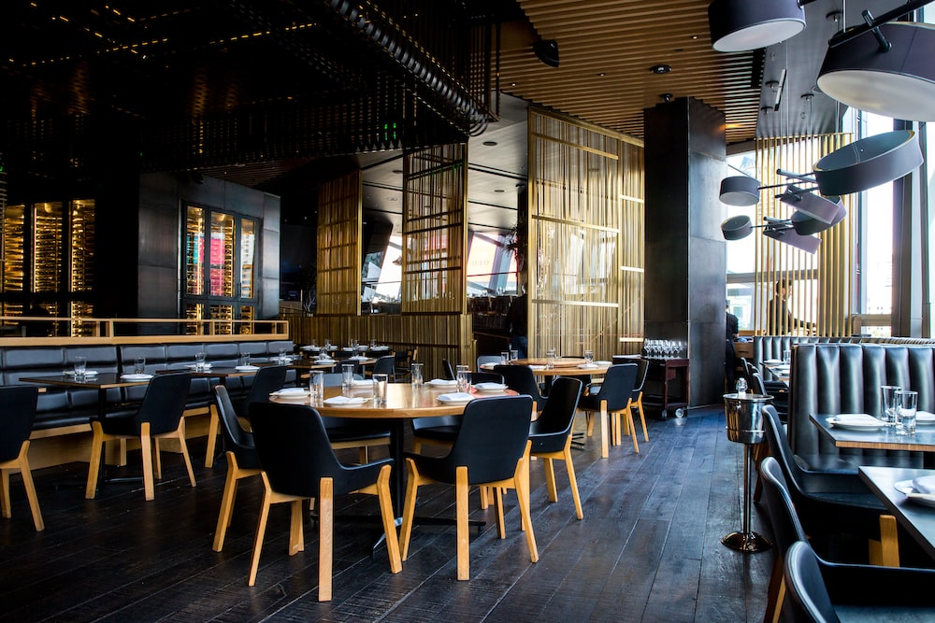
PROJECT INTRODUCTION
ROS (Restaurant One Solution) is a comprehensive software for enhancing restaurant productivity and profitability.
It integrates modules for cash management, HR and scheduling, inventory stock management, mobile app functionality, and dashboard with KPI analytics.
Key goals include operational efficiency, increased revenue and profits, and a single identity for users and restaurants.

Slide 5
BUSINESS MODULE
ACCOUNTING
HR
INVENTORY
FORECASTING
ADMINISTRATION
REPORTS AND DASHBOARDS

Slide 6
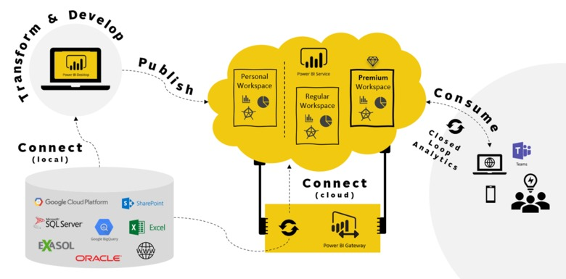
DELIVERY LANDSCAPE
Data Set
Data Dictionary
Data Anomalies
Data Collection
Data Generation
Data Connections
Data Insights

Slide 7

PROJECT REQUIREMENTS
Data Set
Clients
Accounts
Products
Subscriptions
Business Module
Functional Module
Features
Users
Roles
Departments
Restaurants
Countries
Currency
Restaurant Address
Cash up
Banking Info
Petty Cash
Sales
Tax Info
Third Party Info

Slide 8
DELIVERY IN NUMBERS
20
DATA ENTITIES
20
DATA SETS
139
DATA FIELDS
20
TABLES
13
VISUALIZATIONS
10
TECHNIQUES

Slide 9



TECHNOLOGY STACK

Slide 10
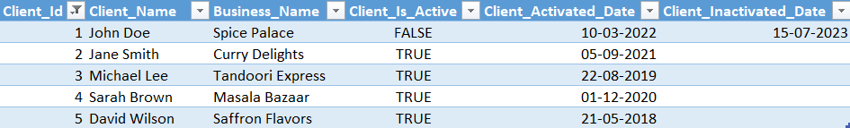
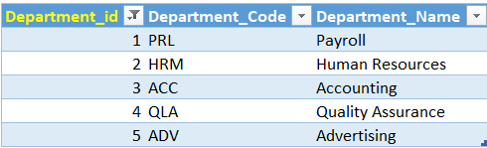

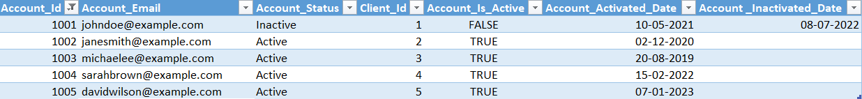
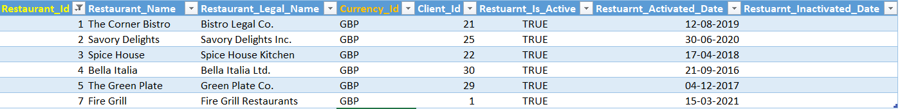
DATA SETS - 20

Slide 11
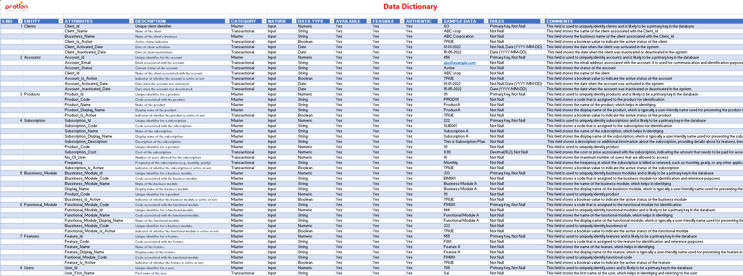
DATA DICTIONARY

Slide 12
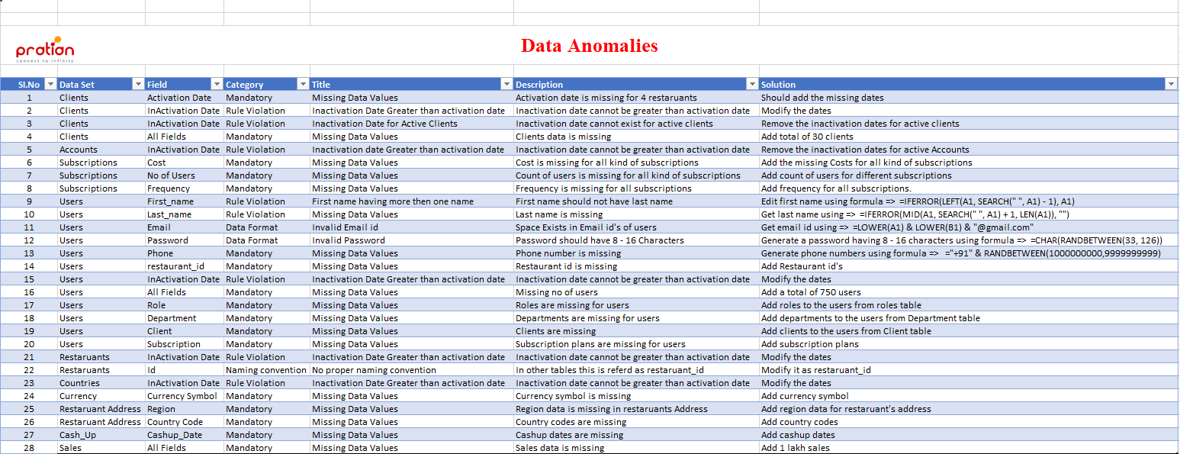
DATA ANOMALIES

Slide 13
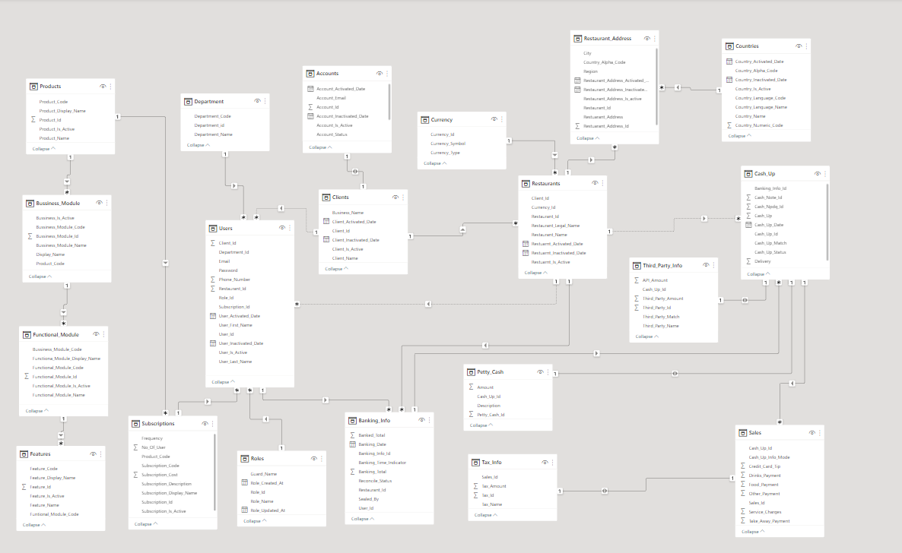
DATABASE DESIGN

Slide 14
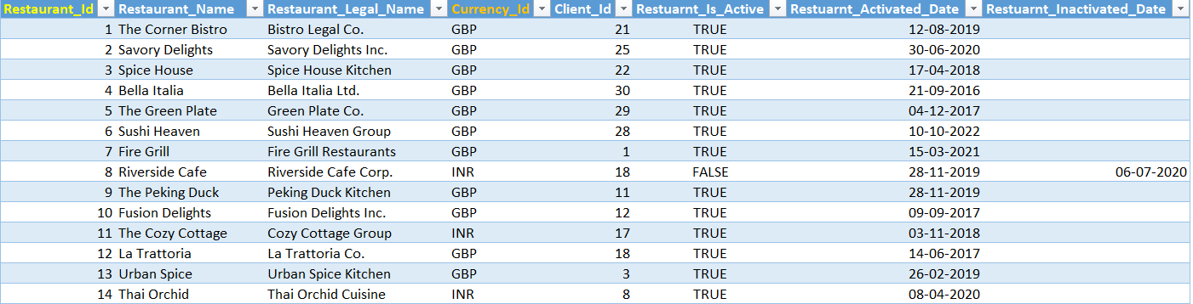
DATA GENERATION
Purpose | Formula
For generating random values | =RANDBETWEEN(X,Y)
Random dates between 2016 to 2023 | =RANDBETWEEN(DATE(2016,1,1), DATE(2023,12,31))
To generate true or false based on two columns | =if(A1=B1)
To get 20% should IND and 80% should UK | =IF(A1<=0.2, IND, UK)
To get user name, password, email etc | https://www.mockaroo.com/
To separate first name & last name | =LEFT(A1, SEARCH(" ", A1) - 1)
Table Name | Number Of Data Generated Rows
Clients | 15
Accounts | 15
Users | 589
Restaurants | 56
Restaurants address | 80
Cash Up | 99900
Sales | 99889

Slide 15
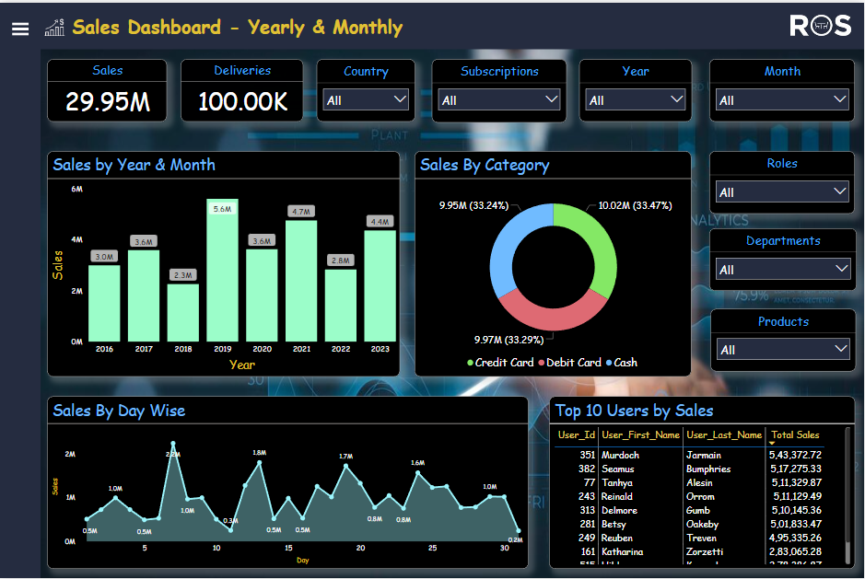
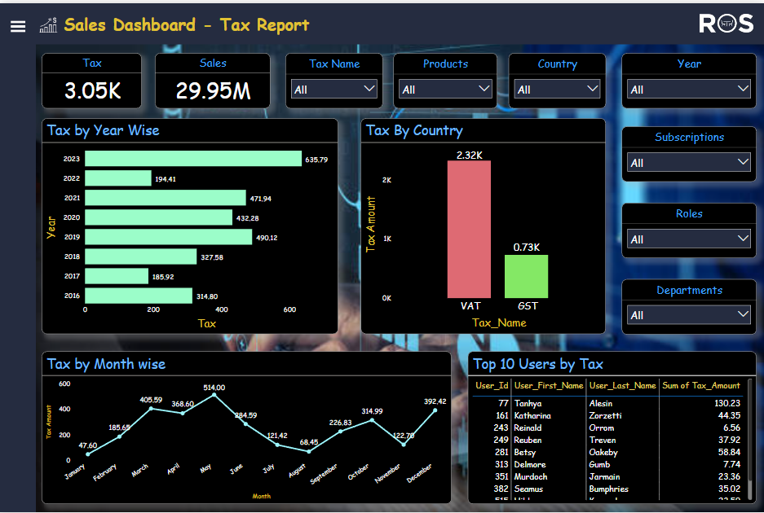
DATA VISUALIZATIONS

Slide 16
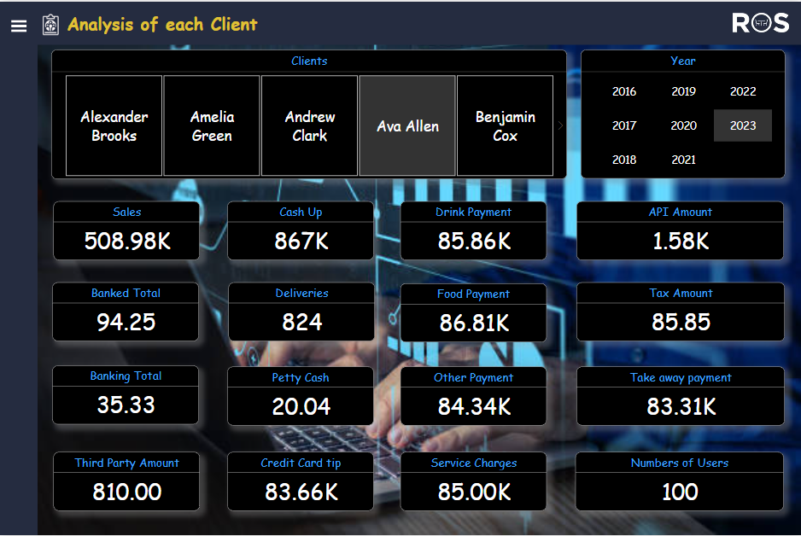
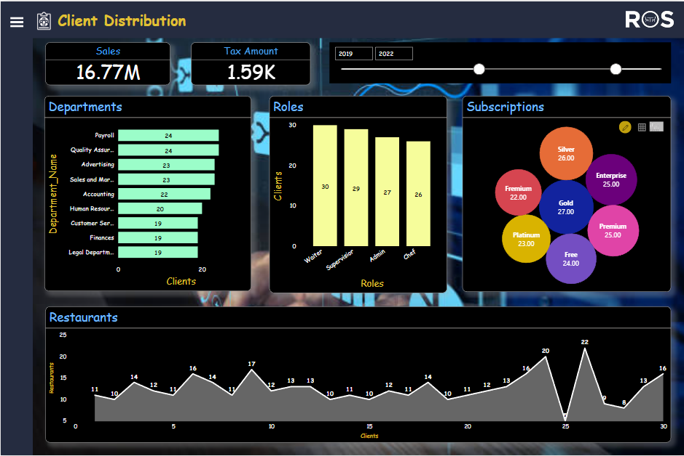
DATA VISUALIZATIONS

Slide 17
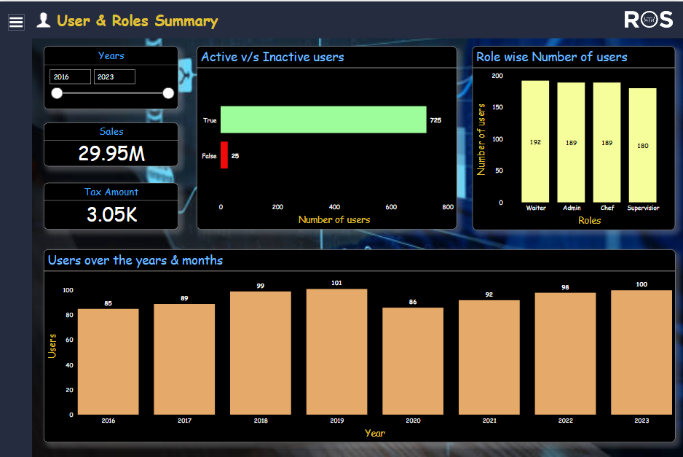
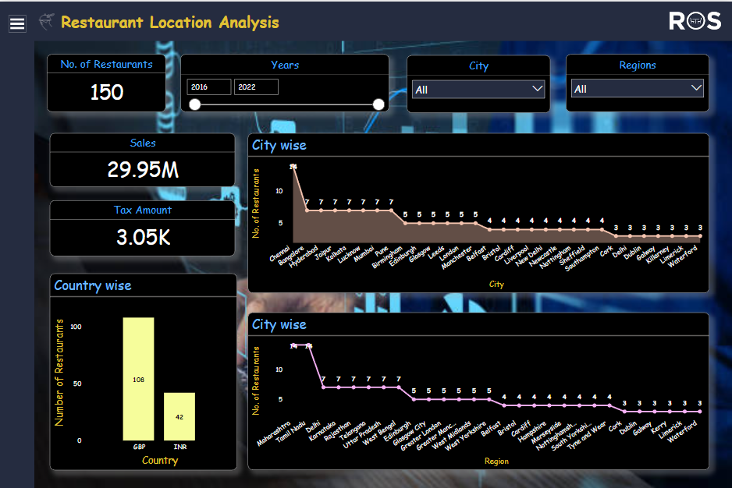
DATA VISUALIZATIONS

Slide 18
OUR TEAM
Name | Batch
Sai Teja Kadimisetti | IBH 18
Soumya Abalur | IBH 18
Siddamsetty Vihal | IBH 18
Neeli Supriya | IBH 18

Slide 19
OUR EXPERIENCE

Slide 20


